Slide 1
FRESHLENS
Sprint 3 - TEAM-4 Sierra

Slide 2
AGENDA
Project Review
Team members
MVP
Technologies
Algorithms
Diagrams
Sprint 2 recap
Product and Sprint 3 Backlog
Metrics
Retrospective
Sprint 4 Plans
Project demo
Github
App demo

Slide 3
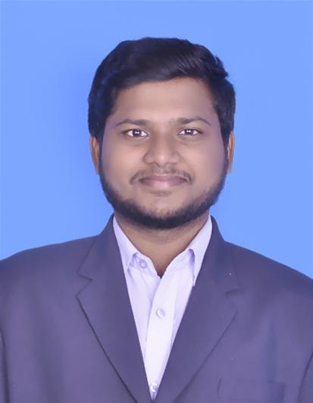
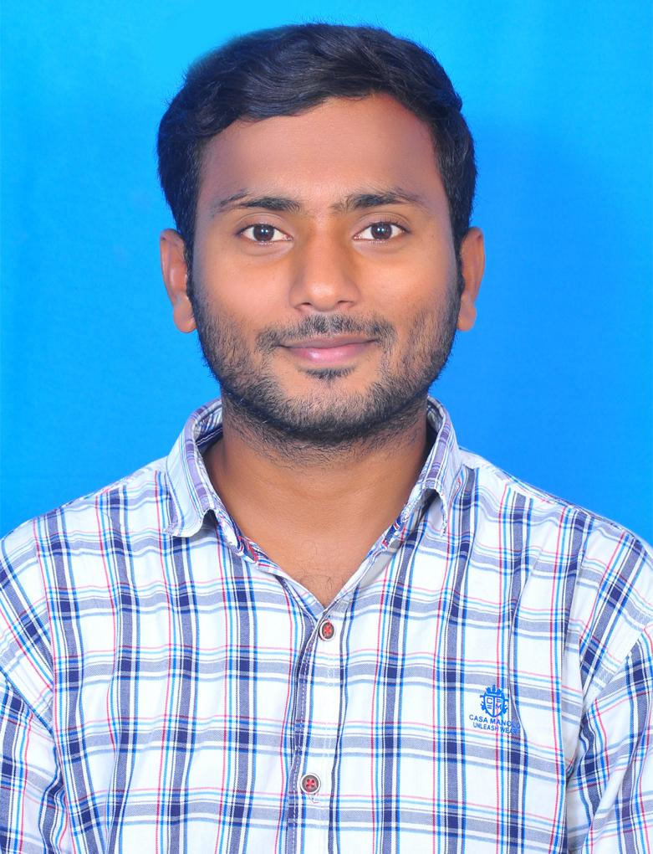
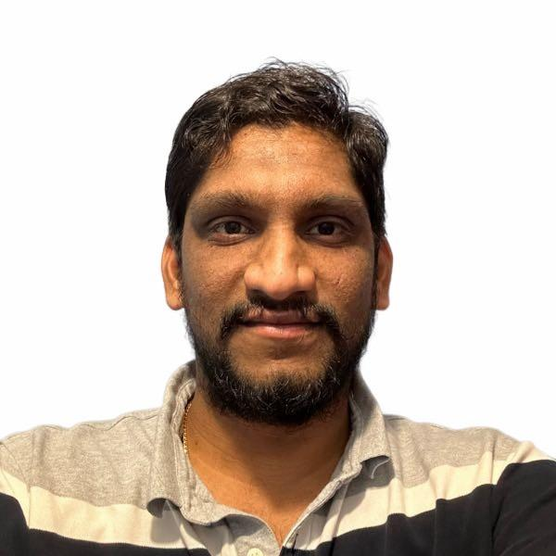
TEAM MEMBERS
Chandu Pentela Project Manager
Jaya Venkata Vara Sai Prakash Perumalla Backend Developer
Banoth Ashok Backend Developer

Slide 4
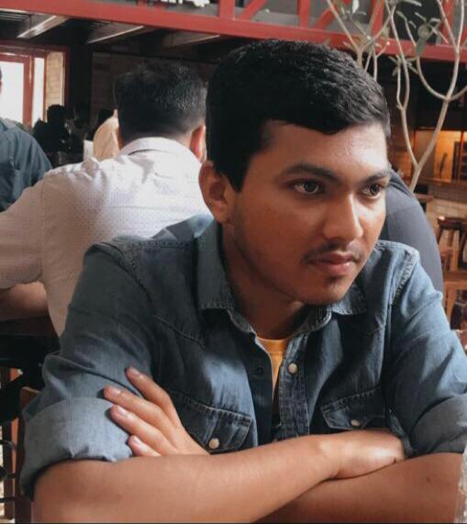
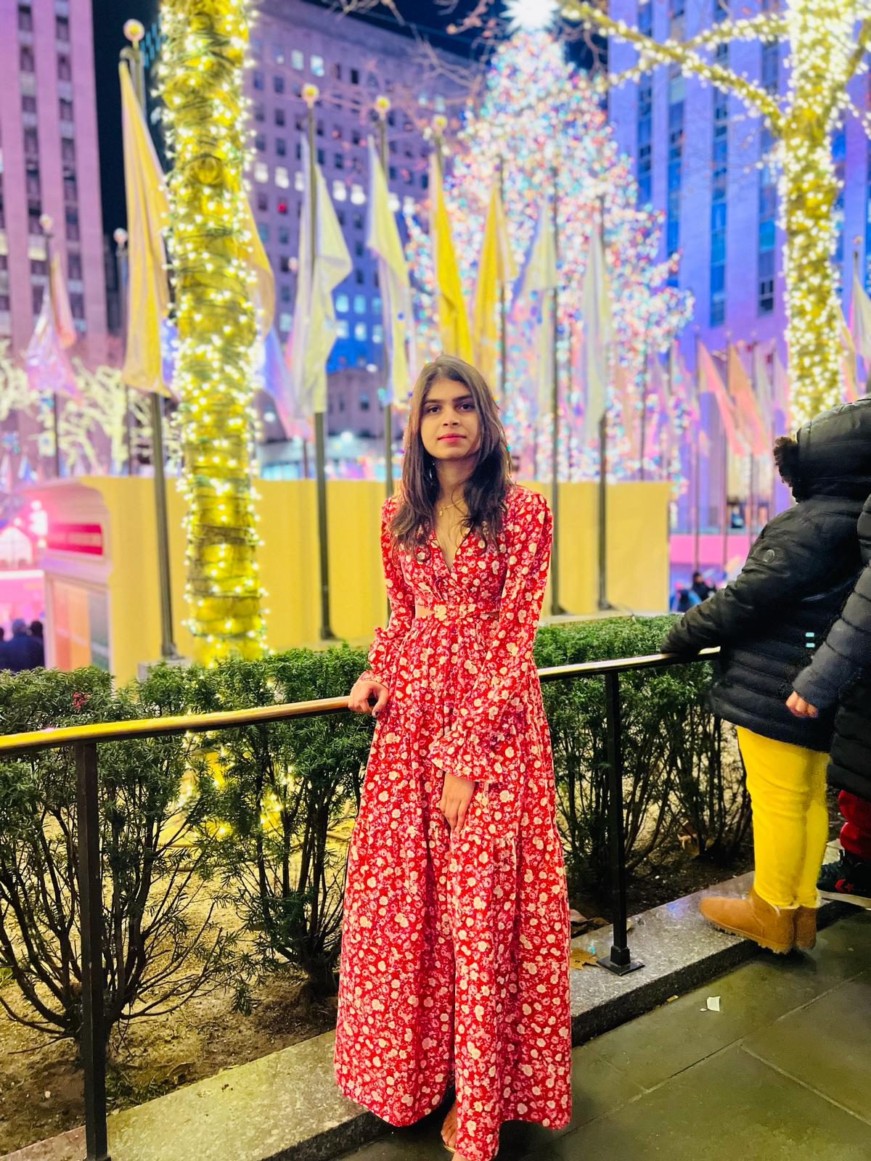
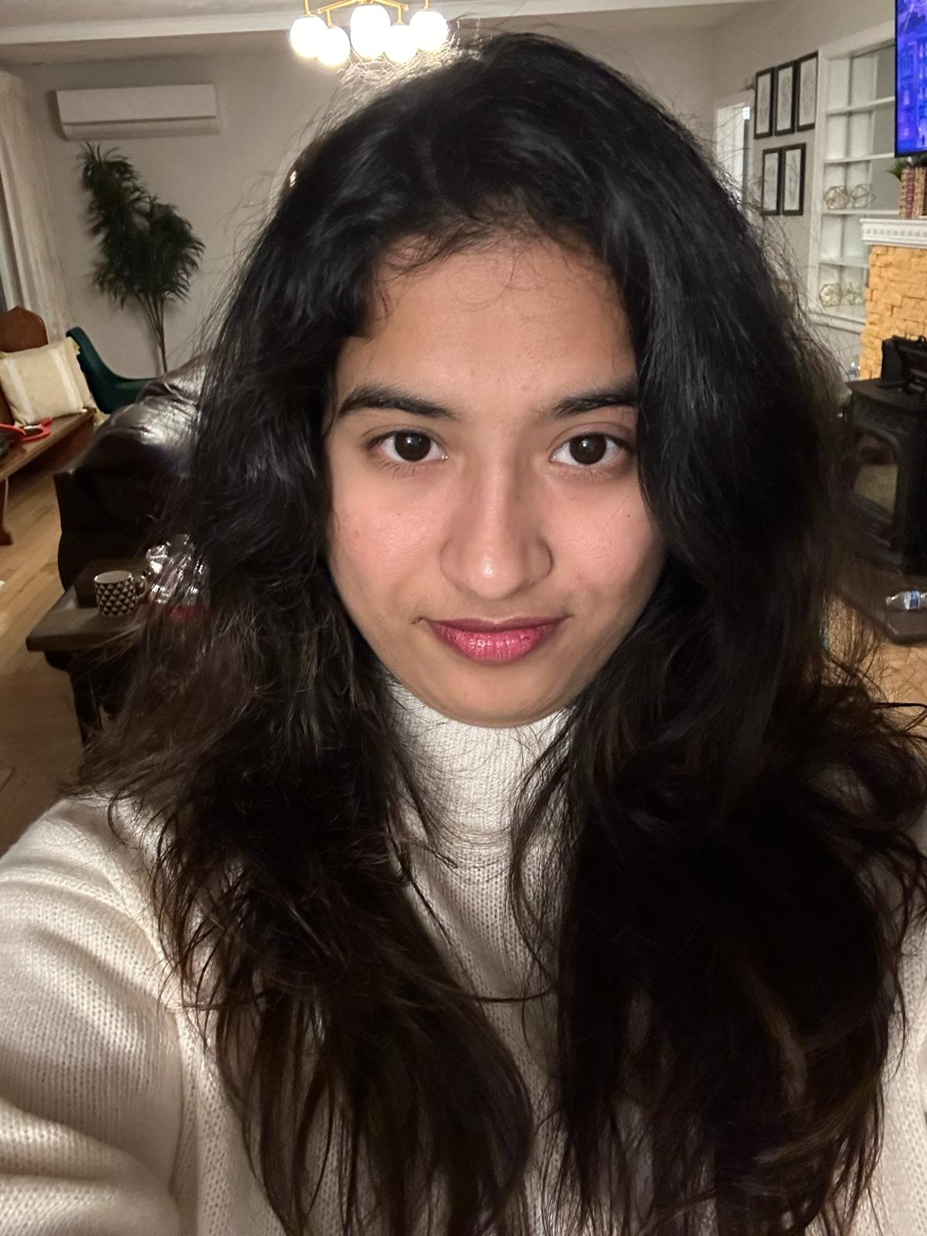
TEAM MEMBERS
Ashish Padma Machine Learning Engineer
Poojitha chinthala Machine Learning Engineer
Sushmitha Reddy Poddaturu Machine Learning Engineer

Slide 5
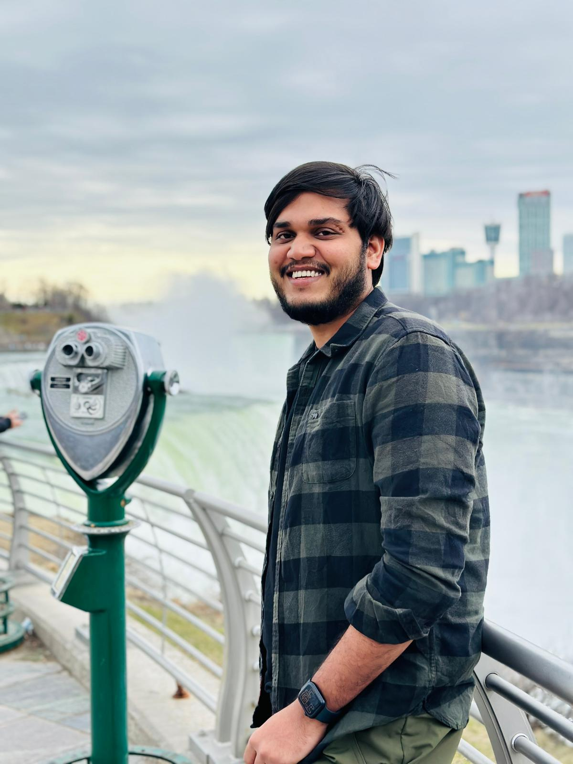
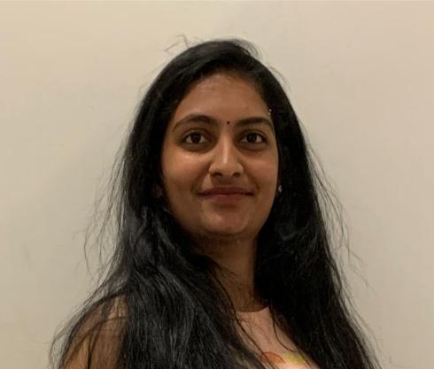
TEAM MEMBERS
Satish kumar reddy indla Developer
Aishwarya Kongari
Developer

Slide 6
Changes based on Professor feedback
Following the checklist order.
Changes in user story, Product backlog and screenshots of the application.

Slide 7
PROBLEM STATEMENT
Many individuals want to maintain a healthy diet but they find it challenging to keep track of their diet and analyse it. The traditional way where keep logging food intake often time and it is prone to inaccuracies, which leads to poor diet choices and even demovitates the individual.
There needs to be a way for a more intuitive and efficient way to understand the nutritional values of fruits and easy to keep track of the intake. Which makes individuals to take healthy diet options.

Slide 8
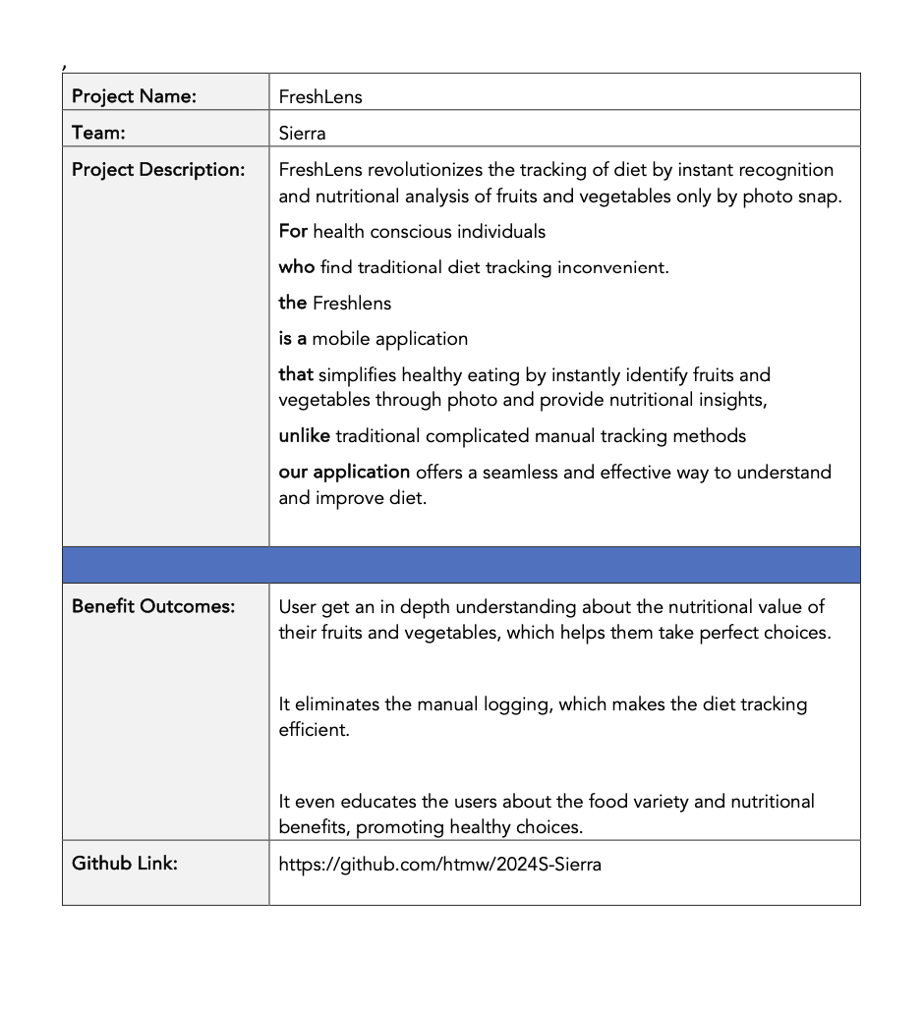
PROJECT DESCRIPTION

Slide 9
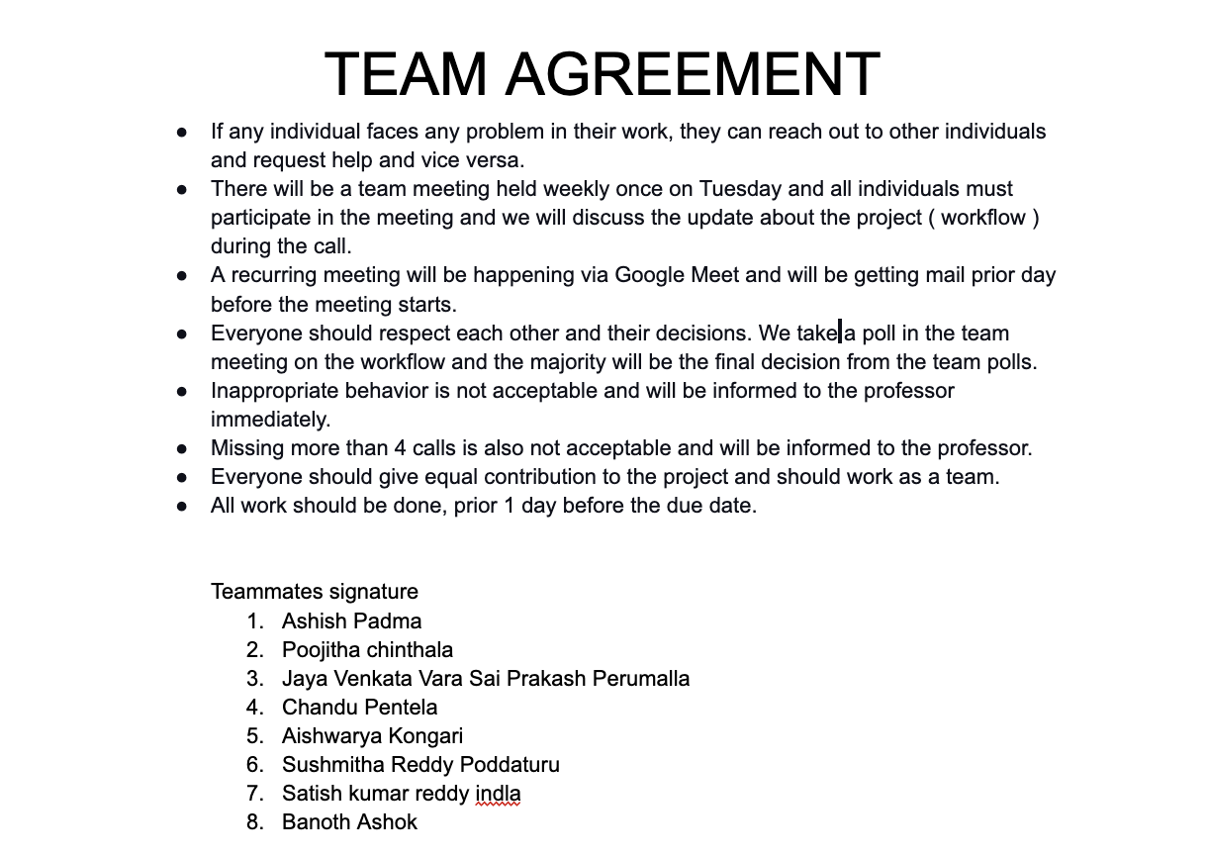
TEAM WORKING AGREEMENT

Slide 10
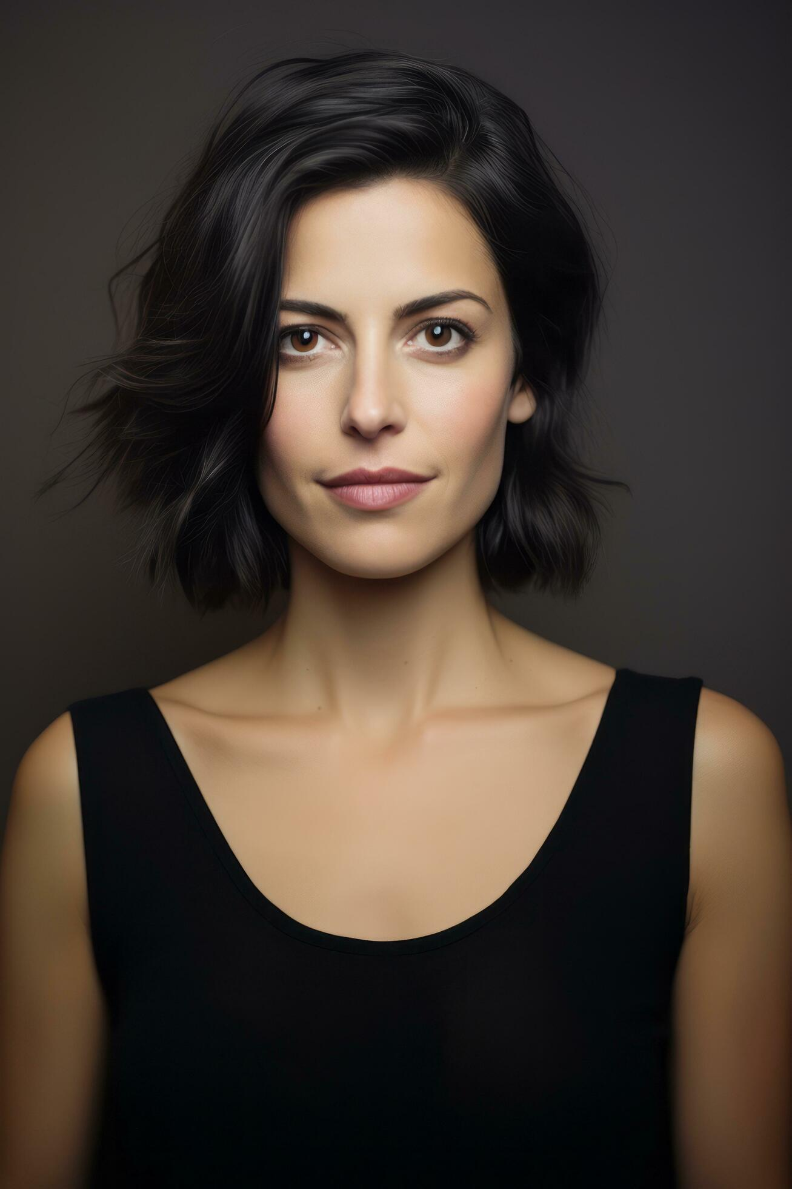
PERSONAS
Name: Emily
Age: 30
Occupation: Marketing Analyst
Interests: Yoga, cooking, and reading health blogs
Goals: Maintain a balanced diet
Challenges: Struggles to find accurate nutritional info for fresh produce
How Your App Helps: FreshLens offers instant nutritional content, supporting her balanced diet and culinary exploration.

Slide 11
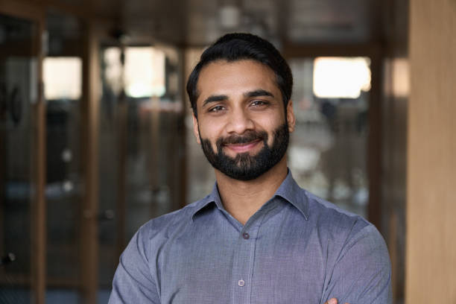
PERSONAS
Name: Alex
Age: 35
Occupation: Software Engineer
Interests: Tech gadgets, hiking, fast cooking
Goals: Eat healthily despite a busy schedule
Challenges: Has limited time for meal prep and nutrition tracking
How Your App Helps: FreshLens easily fits in busy lifestyle, it's designed for healthy eating with quick scan

Slide 12
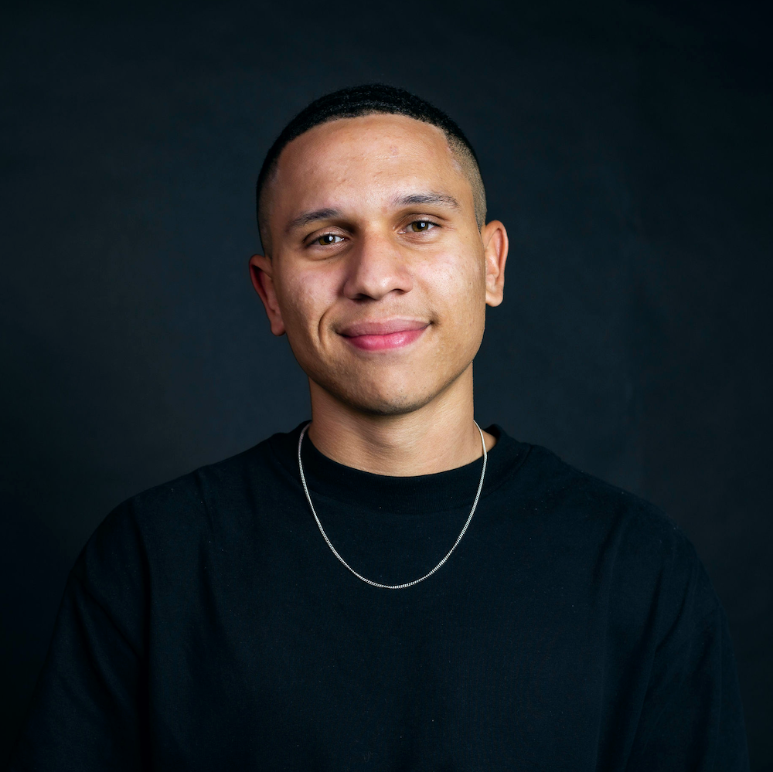
PERSONAS
Name: Jordon
Age: 26
Occupation: Personal Trainer
Interests: Gym workouts, sports nutrition, bodybuilding
Goals: Optimize diet for muscle gain and performance
Challenges: Needs precise macro and micro intake from natural foods
How Your App Helps: FreshLens helps in tracking nutritional values, enhancing his meal planning.

Slide 13
Minimum Viable Product (MVP)
Photo-based food recognition.
User-friendly interface design.
Essential nutritional info display.
User authentication system.
Personal profile customization.
Weekly dietary analysis.

Slide 14


Technologies - Frontend
We will be using React native expo for developing UI for the mobile application and expo is wrapper around react native and it makes prototyping faster.

Slide 15




Technologies - Backend
We will be using node js and fastapi for backend and mongodb as database and its nosql database and even firebase for Authentication and storing images using firebase cloud storage.

Slide 16

Technologies - Machine Learning
We will be using tensorflow to perform machine learning tasking and tensorflow is deep learning framework and it will be used for implementing CNN algorithm.

Slide 17

TECH STACK
Figma is used for designing of the application and sharing the application ideas on how it should look like.

Slide 18
Machine Learning Algorithm
CNN Architecture Algorithm .
In CNN Algorithm. we use DenseNet121.
The DenseNet model is trained using fruits and vegetables dataset. Due to its efficiency and high accuracy, DenseNet model effectively learns from the data and accurately identifies objects.

Slide 19
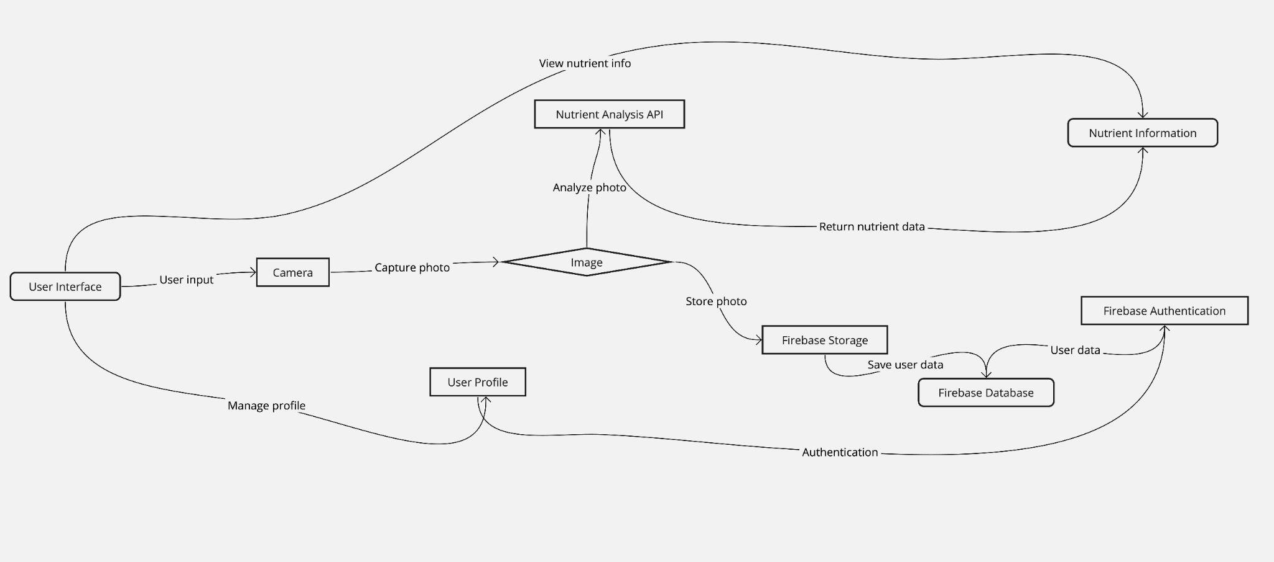
Conceptual Architecture Diagram

Slide 20
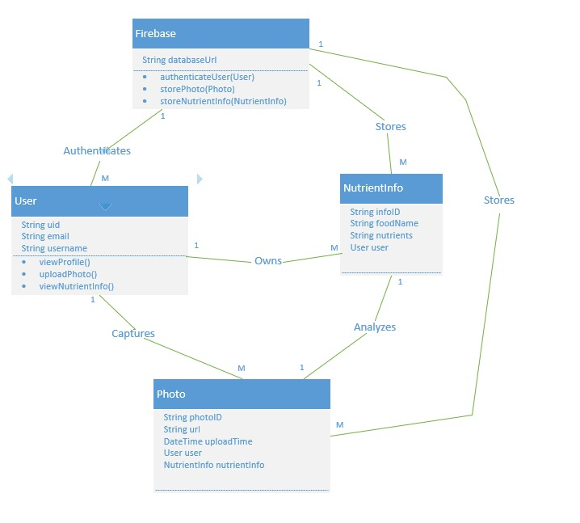
Class Diagram

Slide 21
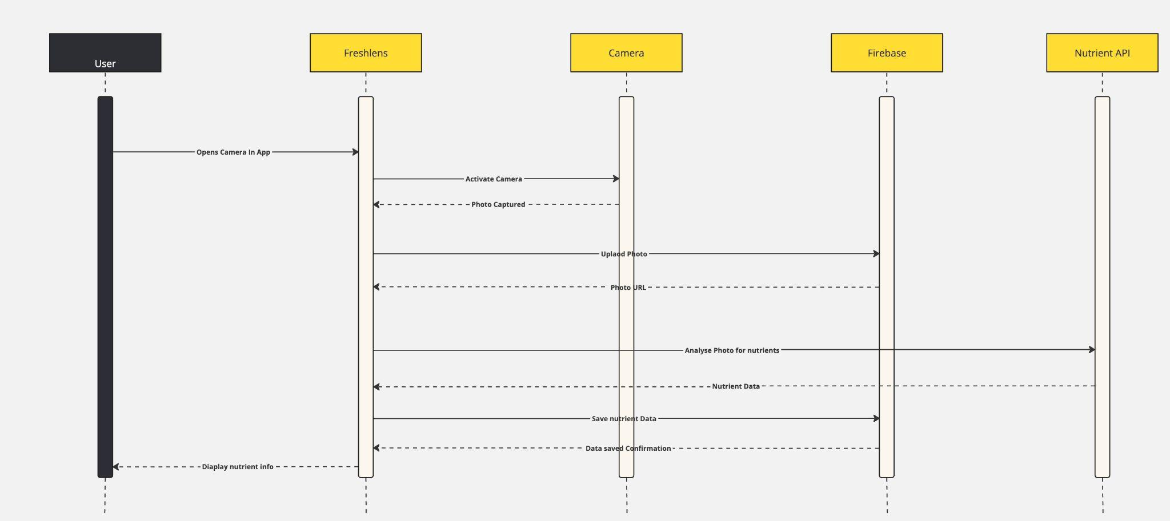
Sequence Diagram

Slide 22
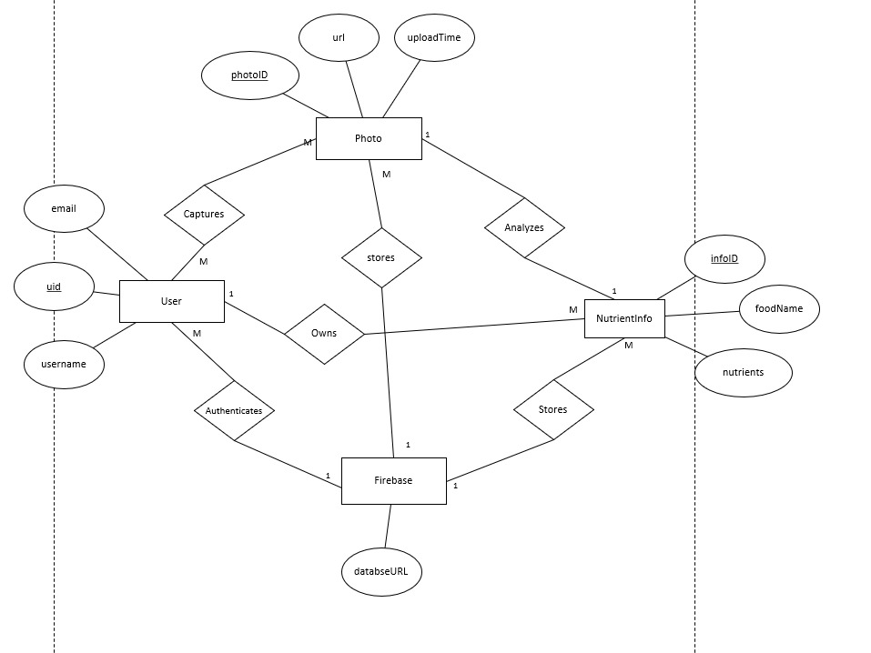
Entity Relationship Diagram

Slide 23
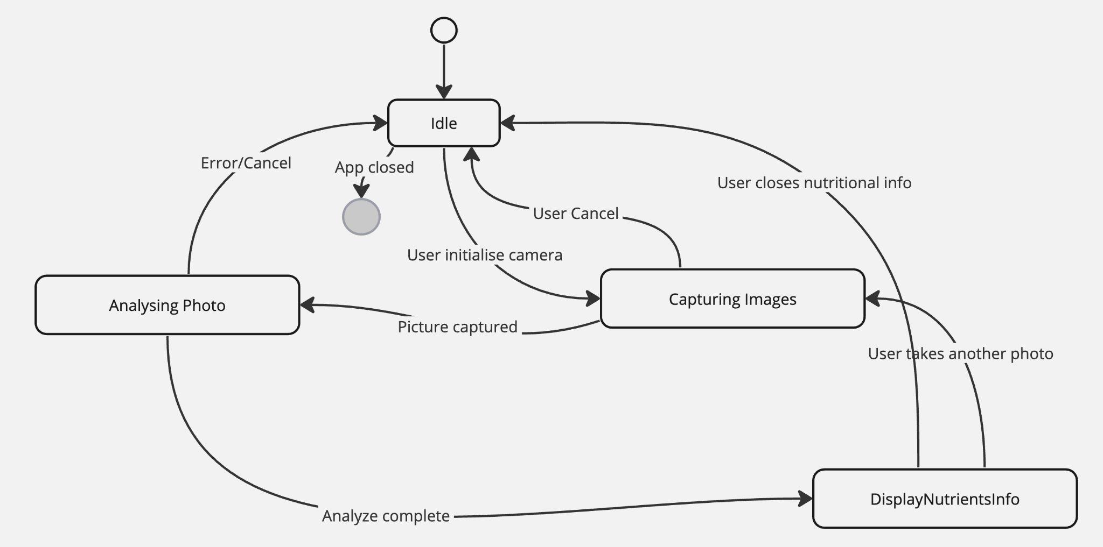
State diagram

Slide 24
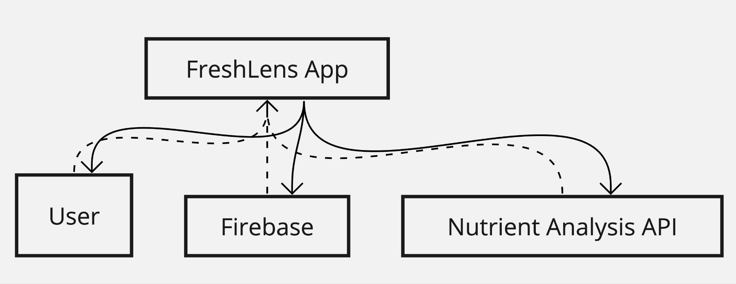
Context Diagram

Slide 25
Sprint 2 backlog
Basic implementation of all application screens such as camera , favourite and profile screens.
Exploratory data analysis is performed for fruits dataset.

Slide 26
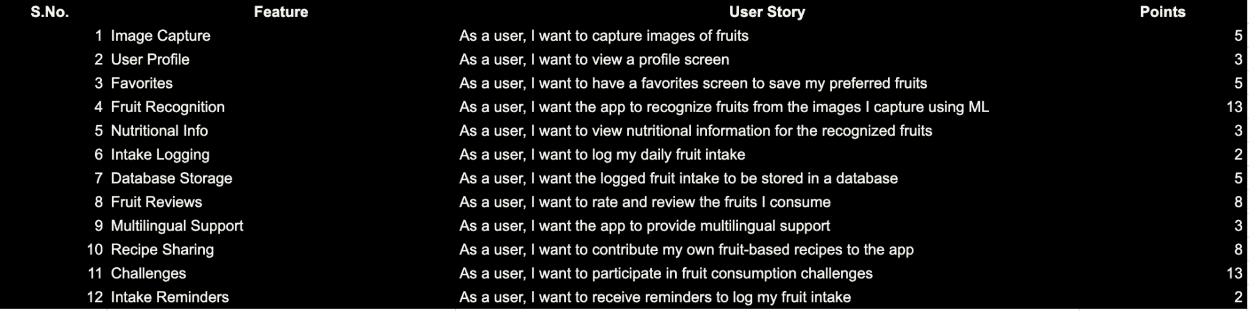
Product Backlog

Slide 27
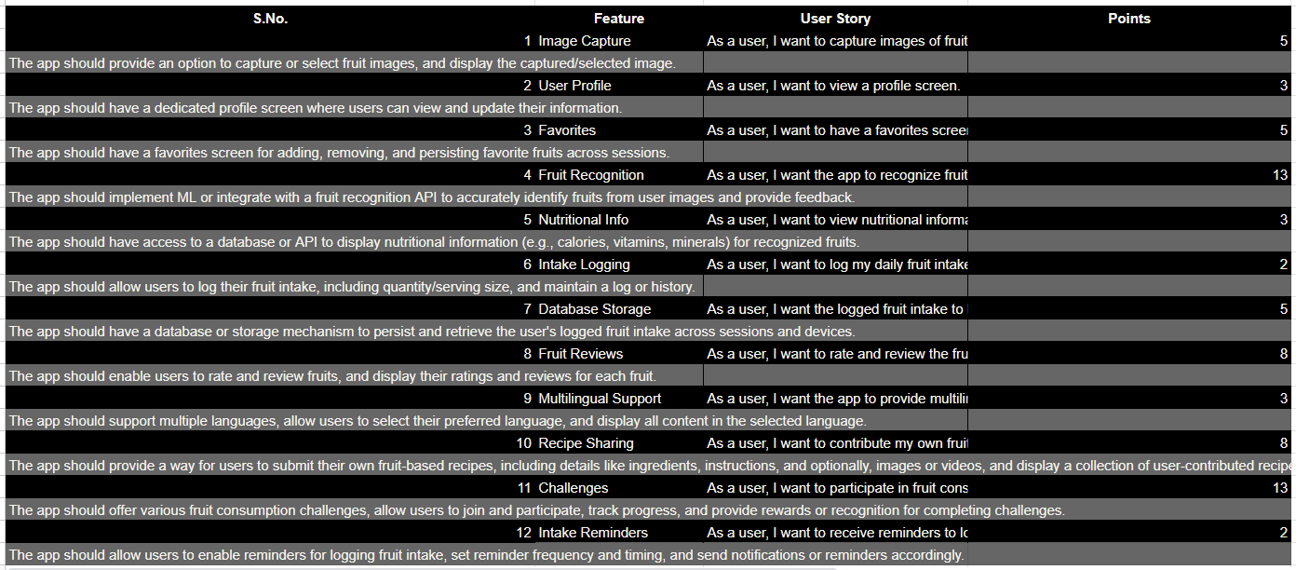
User Stories and Acceptance Criteria
Black colour is highlighted for user stories and grey colour for Acceptance criteria

Slide 28
User Stories and Acceptance Criteria
Black colour is highlighted for user stories and grey colour for Acceptance criteria

Slide 29
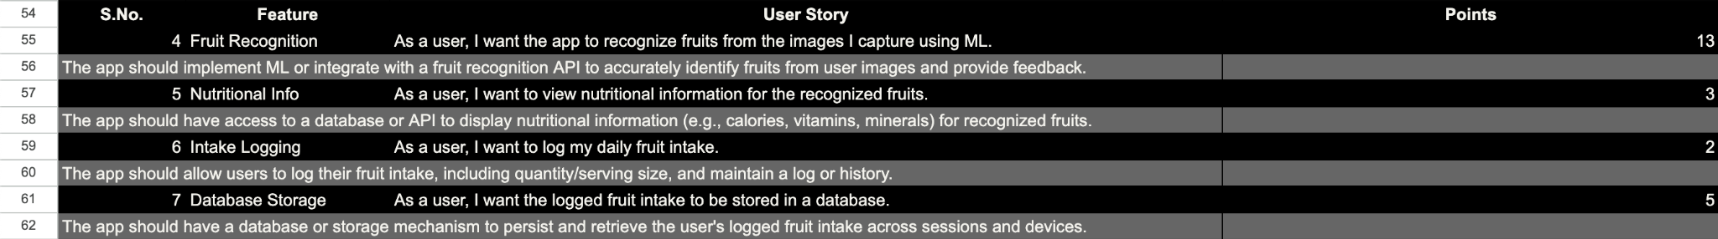
Sprint 3 Backlog
Black colour is highlighted for user stories and grey colour for Acceptance criteria

Slide 30
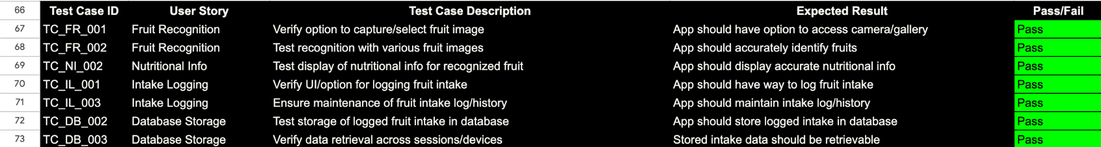
Test Cases

Slide 31
Stories Completed

Slide 32
Metrics
Team Velocity: 23 points
Average Velocity: 31.5 points
Completed Committed Ratio for Sprint 3:
23/23 - 100%

Slide 33
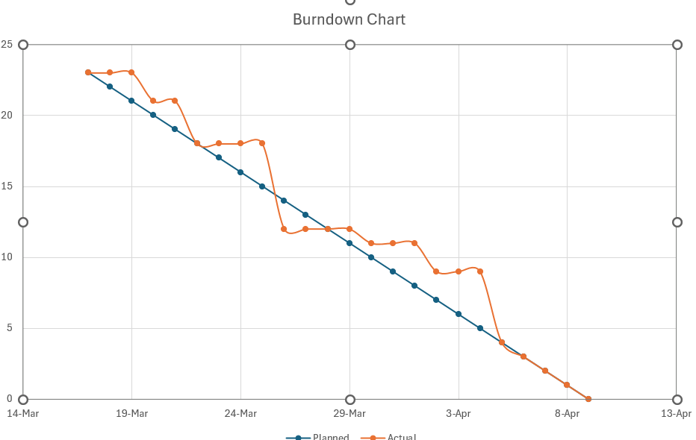
Burndown chart

Slide 34
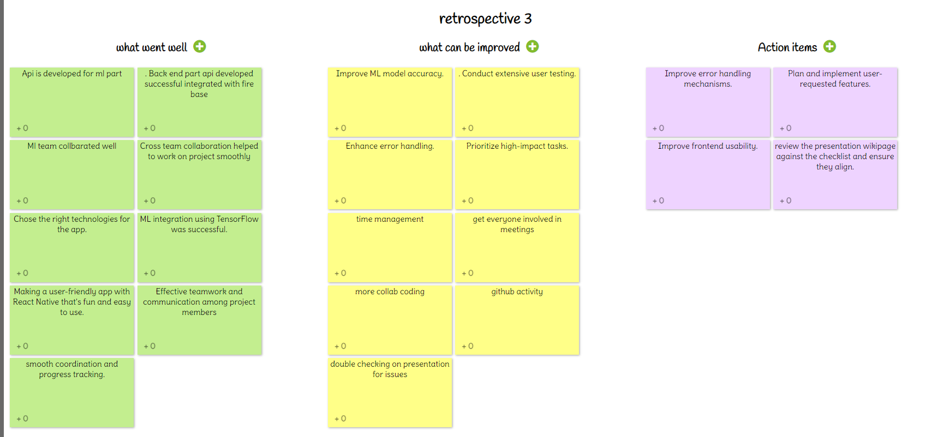
RETROSPECTIVE

Slide 35
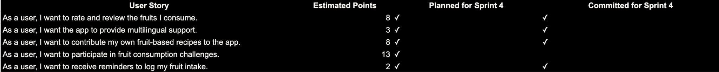
Sprint 4 Planned and Committed Stories

Slide 36
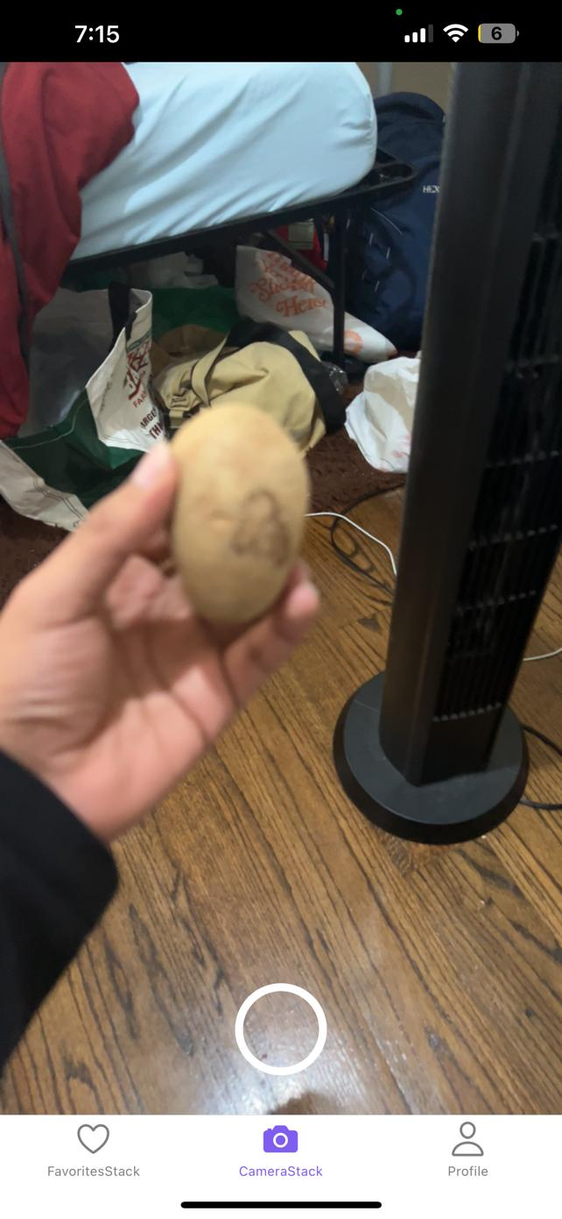
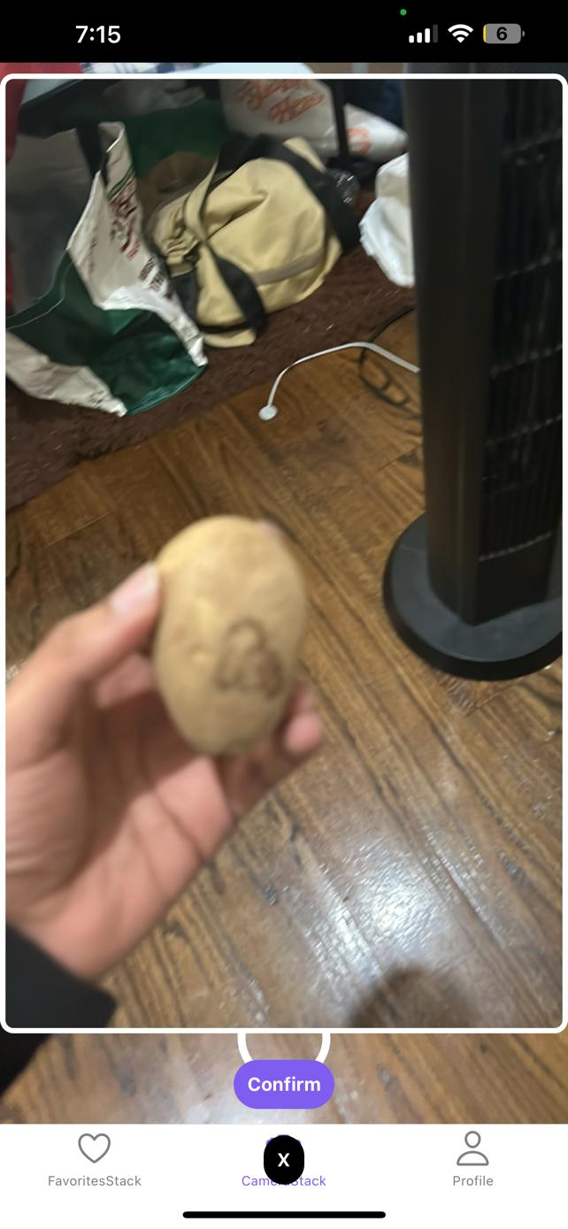
Demo Screenshots
Capture Modal
Favorite
Screen

Slide 37
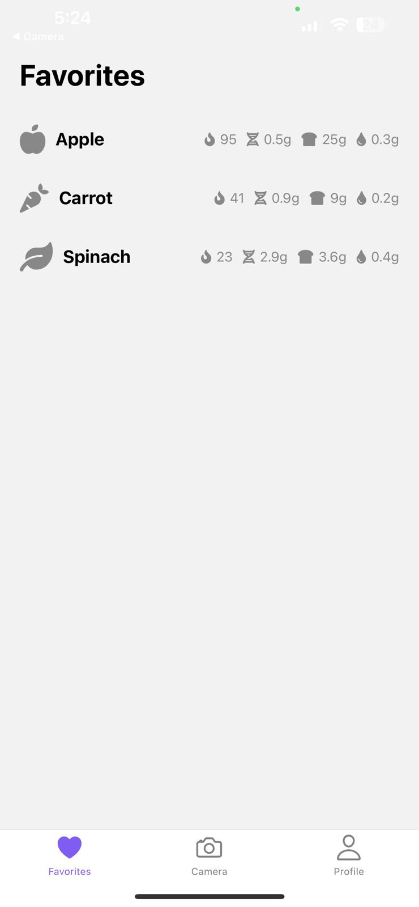
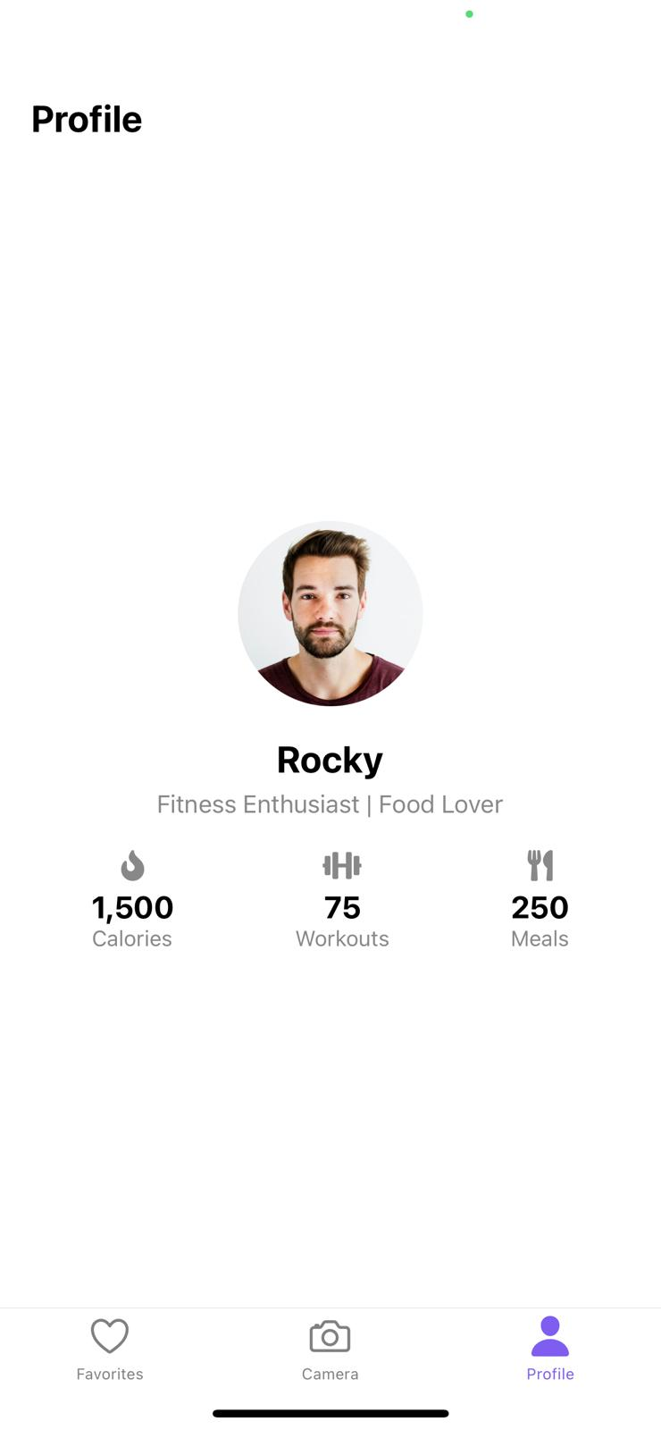
Demo Screenshots
Favorite
Screen
Profile Screen

Slide 38
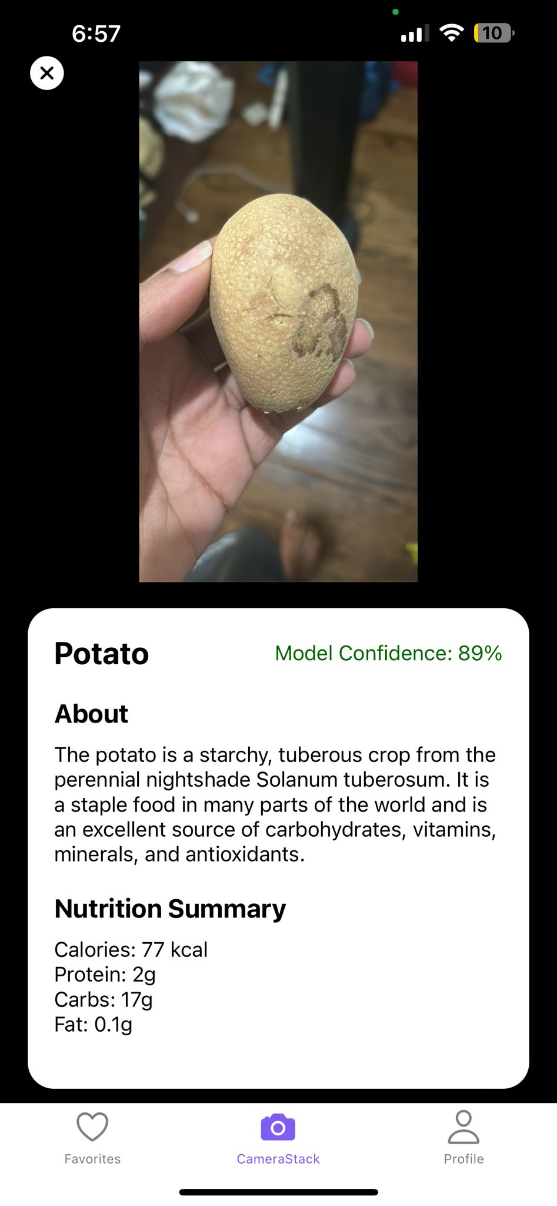
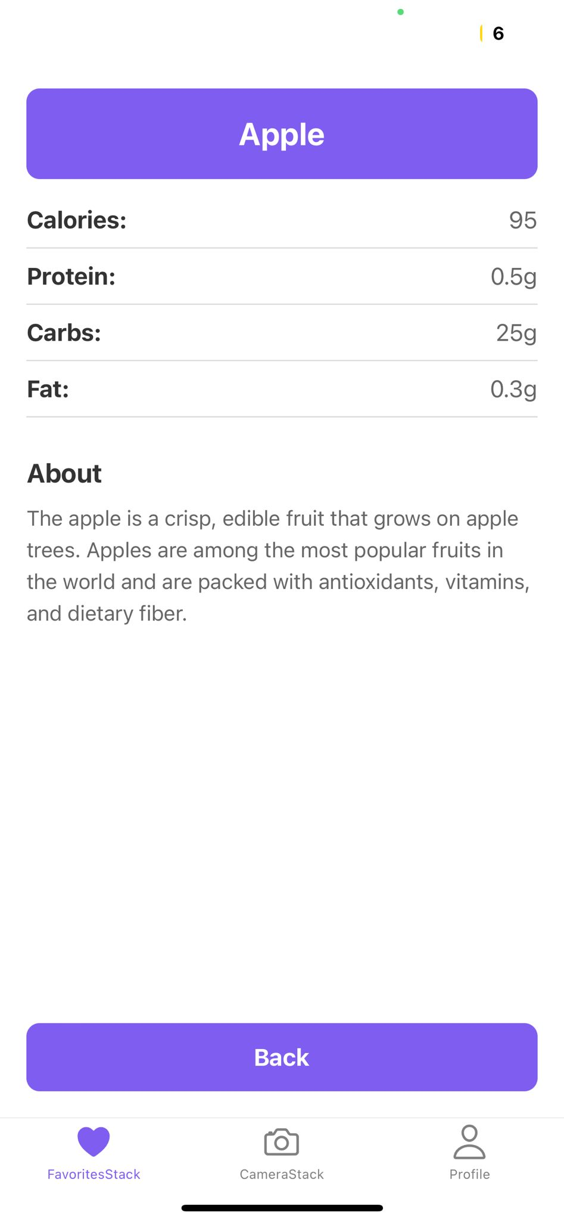
Application

Slide 39
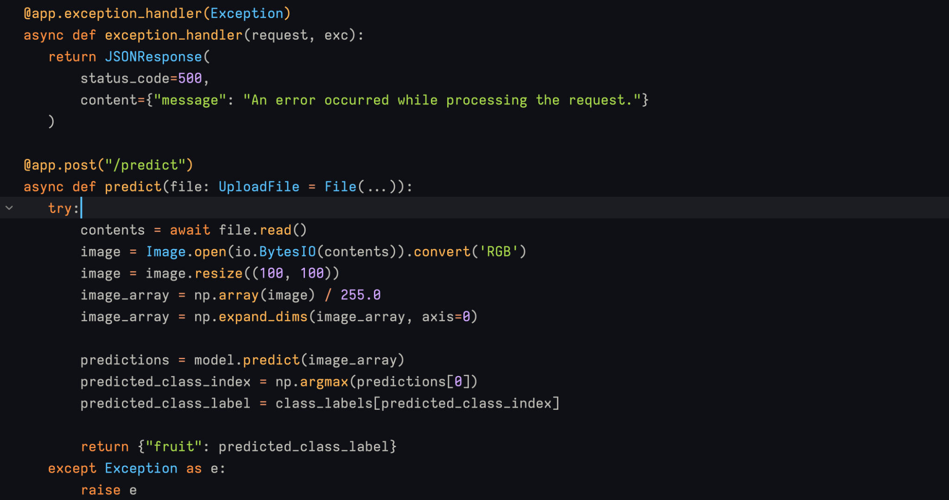
FastAPI

Slide 40
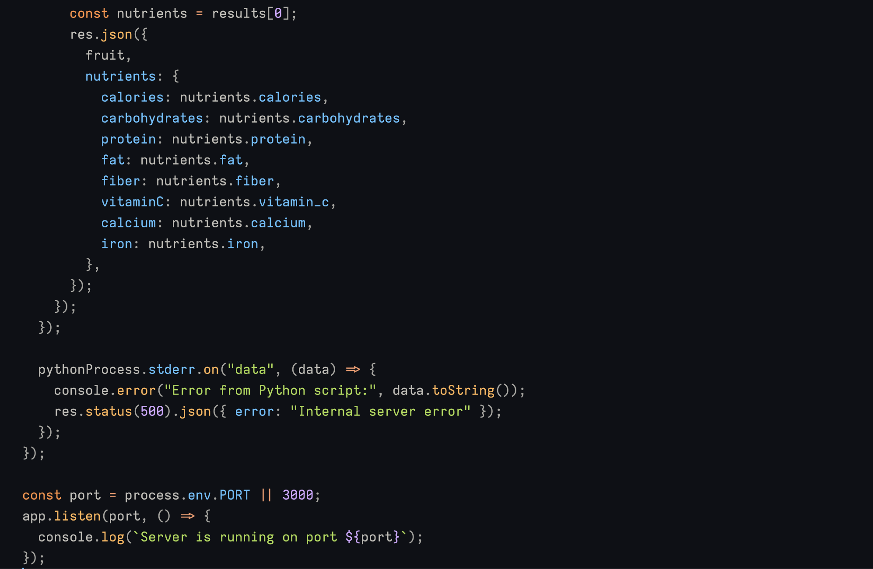
Node JS Api

Slide 41
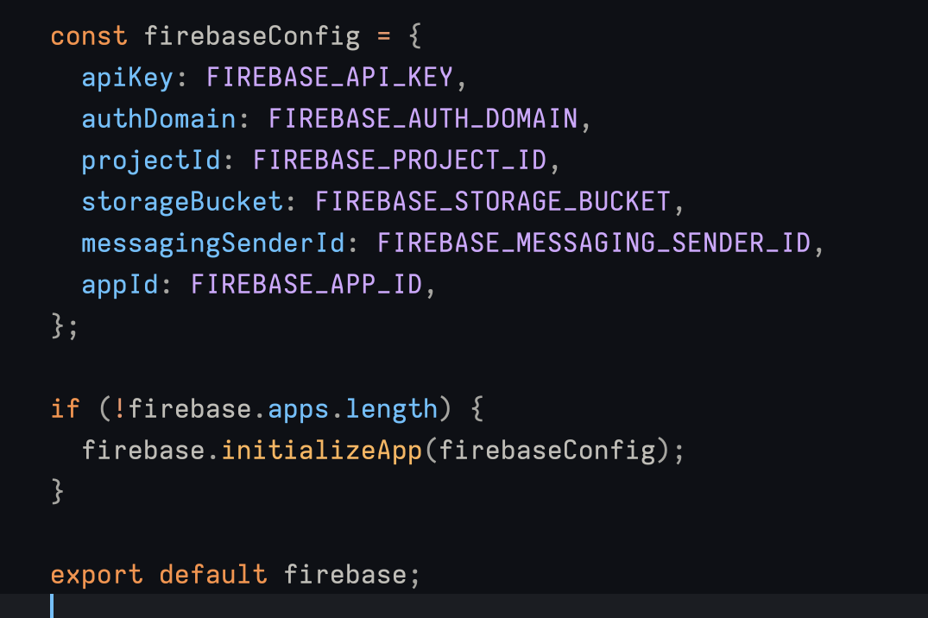
Firebase API

Slide 42
Wikipage link
https://github.com/htmw/2024S-Sierra/wiki

Slide 43
Application Demo

Slide 44
THANK YOU

